Slide 1
Python Mid Term Project Analysis of Key Indicators of Heart Disease
Team members:
Arjun Mahajan
Sayali Sawant
Pranjali Chandgadkar
Puneeth Chowdhary

Slide 2

Abstract
This project examines the 2022 Key Indicators of Heart Disease dataset, sourced from the CDC's Behavioral Risk Factor Surveillance System (BRFSS), which includes health data from over 400,000 U.S. adults. Using Python's pandas for data manipulation and matplotlib for visualization, we perform Exploratory Data Analysis (EDA) to identify key factors influencing the likelihood of heart disease. The analysis highlights the relationships between various risk factors, such as high blood pressure, cholesterol levels, smoking, diabetes status, obesity, and physical inactivity, and the prevalence of heart disease. Through visualizations and summary statistics, we uncover patterns and correlations within the data, providing insights into which variables have the greatest impact on heart disease risk. By identifying trends and discrepancies, this study informs strategies for preventive healthcare and early detection, offering actionable insights to improve public health interventions and resource allocation for heart disease prevention

Slide 3
Introduction
Heart disease remains a leading cause of death in the United States, with numerous health factors contributing to its prevalence.
Identifying and understanding these key indicators is essential for improving preventive healthcare.
This project focuses on analyzing health data related to heart disease from the 2022 Key Indicators of Heart Disease dataset, sourced from the CDC’s Behavioral Risk Factor Surveillance System (BRFSS).
The dataset includes critical health metrics such as blood pressure, cholesterol, smoking, diabetes, obesity, and physical activity levels.
Through exploratory data analysis (EDA) and visualization techniques, we aim to uncover patterns and correlations between these health factors and the likelihood of heart disease.
By identifying significant risk factors, this study provides insights that can inform targeted health interventions, improve early detection strategies, and ultimately contribute to better public health management for heart disease prevention.

Slide 4
EDA!
Introduction
to
Exploratory Data Analysis (EDA) is a crucial step in any data science or machine learning project. EDA is a data exploration and discovery phase that provides a comprehensive understanding of the data, helping to inform decisions throughout the analysis process. It guides how to clean the data, what models to apply, which assumptions need to be checked, and ultimately, how to interpret the data meaningfully. It's a foundational step for ensuring that any insights derived from the data are valid and actionable.

Slide 5
Here's how EDA is helpful in data analysis
Understanding the Data
Data Quality Assessment
Identifying Patterns and Trends
Initial Insight: EDA helps you get a quick understanding of the data structure.
Summary Statistics: By generating summary statistics e.g., mean, median, standard deviation, we can gain insight into the central tendency, spread, and shape of the data
Missing Values: Helps in identifying missing or null values, which can be addressed later
Outliers and Anomalies: crucial for detecting outliers or extreme values that could skew analysis
Duplicates: It helps identify duplicated data points
Discover Patterns: Through visualizations e.g., histograms, box/scatter plots, EDA helps in spotting trends, correlations, and potential patterns in the data.
Identify Relationships: It can reveal relationships between variables making the data visually interpretable
Hypothesis Generation:
Choosing the Right Model
EDA helps in generating new hypotheses or questions about the data guiding the next steps of analysis.
By visualizing the relationships between variables, you can gain insights into which type of models might work best

Slide 6
Dataset
The data contain 4,45,132 rows and 40 columns
State | The state or region where the participant is located, possibly to analyze regional variations in health outcomes.
Sex | Participant’s gender, often relevant as heart disease risk can vary between genders.
GeneralHealth | Self-assessed general health status, which may range from excellent to poor.
PhysicalHealthDays | Number of days in the past month the participant felt physically unwell.
MentalHealthDays | Number of days in the past month the participant felt mentally unwell.
LastCheckupTime | Time since the last medical checkup, possibly in months or years, as regular checkups can impact heart disease risk.
PhysicalActivities | Whether the participant engages in regular physical activities, a factor known to reduce heart disease risk.
SleepHours | Average number of hours the participant sleeps per night, as sleep quality and duration affect heart health.
RemovedTeeth | Number of teeth removed, as oral health can sometimes correlate with cardiovascular health.
HadHeartAttack | Indicates if the participant has had a heart attack, relevant for identifying individuals at high risk.
HadAngina | Indicates if the participant has experienced angina, which may suggest underlying coronary artery disease.
HadStroke | Indicates if the participant has had a stroke, which can be a comorbid condition with heart disease.
HadAsthma | Asthma history, as respiratory issues can sometimes exacerbate cardiovascular conditions.
HadSkinCancer | Indicates if the participant has had skin cancer, possibly reflecting general health status.
HadCOPD | Indicates if the participant has chronic obstructive pulmonary disease, which can increase heart disease risk.
HadDepressiveDisorder | Indicates if the participant has been diagnosed with depression, which can impact heart health.
HadKidneyDisease | Indicates if the participant has kidney disease, as this condition is closely linked to heart disease.
HadArthritis | Indicates if the participant has arthritis, potentially associated with inflammation that affects heart health.

Slide 7
Dataset
HadDiabetes | Indicates if the participant has diabetes, a major risk factor for heart disease.
DeafOrHardOfHearing | Hearing status, as some studies explore links between hearing loss and cardiovascular health.
BlindOrVisionDifficulty | Vision status, included perhaps as a general health indicator.
DifficultyConcentrating | Whether the participant experiences difficulty concentrating, possibly relevant if cognitive decline is tracked.
DifficultyWalking | Indicates if the participant has mobility issues, potentially related to cardiovascular health.
DifficultyDressingBathing | Indicates if the participant has difficulty with self-care tasks, reflecting general health and independence.
DifficultyErrands | Whether the participant finds it hard to run errands, possibly reflecting overall physical or mental health limitations.
SmokerStatus | Indicates if the participant is a smoker, a major risk factor for heart disease.
ECigaretteUsage | Use of e-cigarettes, as nicotine consumption impacts cardiovascular health.
ChestScan | Indicates if the participant has undergone a chest scan, potentially to assess lung or heart health.
RaceEthnicityCategory | Participant’s race or ethnicity, as some populations have higher heart disease risks.
AgeCategory | Age group of the participant, as age is a key risk factor for heart disease.
HeightInMeters | Participant’s height, used in conjunction with weight to calculate BMI.
WeightInKilograms | Participant’s weight, also used for BMI calculation.
BMI | Body Mass Index, a measure of body fat, with high BMI often associated with increased heart disease risk.
AlcoholDrinkers | Indicates if the participant consumes alcohol, as excessive drinking is linked to heart disease.
HIVTesting | Indicates if the participant has been tested for HIV, perhaps included for general health monitoring.
FluVaxLast12 | Indicates if the participant has received a flu vaccine in the past year, as vaccination may reflect health awareness.
PneumoVaxEver | Indicates if the participant has ever received a pneumonia vaccine, relevant for general health.
TetanusLast10Tdap | Indicates if the participant has received a tetanus booster in the last 10 years, another general health indicator.
HighRiskLastYear | Indicates if the participant was considered high-risk in the past year, possibly due to underlying health conditions.
CovidPos | Indicates if the participant has tested positive for COVID-19, as COVID-19 has been associated with long-term heart complications.

Slide 8
Preprocessing
Identified Null Values: First, checked for missing values in the dataset. If a column contained more than 10,000 null values, the following steps were taken:
For numerical columns, replaced the null values with the mean of the respective column.
For categorical columns, replaced the null values with the mode (most frequent value) of that column.
If the number of null values was less than 10,000, the rows with missing data were dropped

Slide 9
Literature Review
S.No. | Author | Paper and Publication | Findings
1. | K. G. Kannel, W. P. Stokes, J. L. Vokonas, and S. P. Wolf | "The Role of Hypertension and Hyperlipidemia in the Development of Cardiovascular Disease” Journal: Archives of Internal Medicine (1994) DOI: 10.1001/archinte.1994.00420080089008 | This paper highlights that hypertension and high cholesterol significantly increase heart disease risk, especially in older adults. It stresses the importance of managing these factors through lifestyle changes and medication, which aligns with your study's findings.
2. | R. M. L. Vasan, S. D. Wilson, D. R. Kannel, and W. B. Fine | "Obesity, Physical Activity, and Risk of Heart Disease in a Large Population-Based Study" Journal: Journal of the American College of Cardiology (2009) DOI: 10.1016/j.jacc.2009.05.009 | This study finds that obesity, especially abdominal fat, and physical inactivity are major independent risk factors for heart disease. It suggests that increasing physical activity and managing obesity through behavioral interventions could significantly reduce heart disease risk, aligning with your study's findings.

Slide 10
Architecture/Methodology
Understanding the dataset context
Import Libraries and Load Data
Initial Data inspection
Data Cleaning
Univariate Analysis
Bivariate Analysis
Multivariate Analysis
Visualization and Interpretation

Slide 11
Results

Slide 12

Univariate Analysis
Summary Statistics: Review measures of central tendency (mean, median) and dispersion (standard deviation, variance).
Visualize Distributions: Use histograms, box plots to understand the distribution of individual variables.

Slide 13
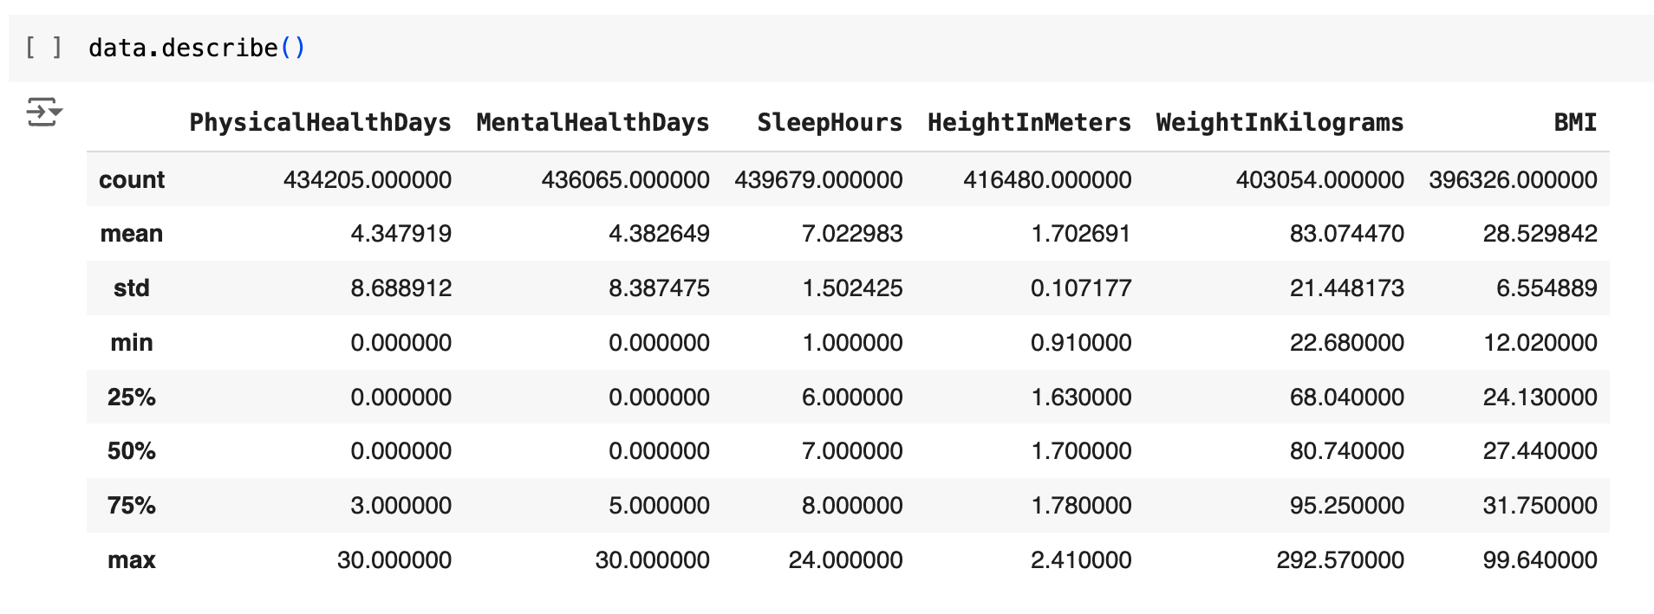
Statistical Analysis for Numerical Data
Analysis 1: Statistical Analysis for Numerical Data

Slide 14
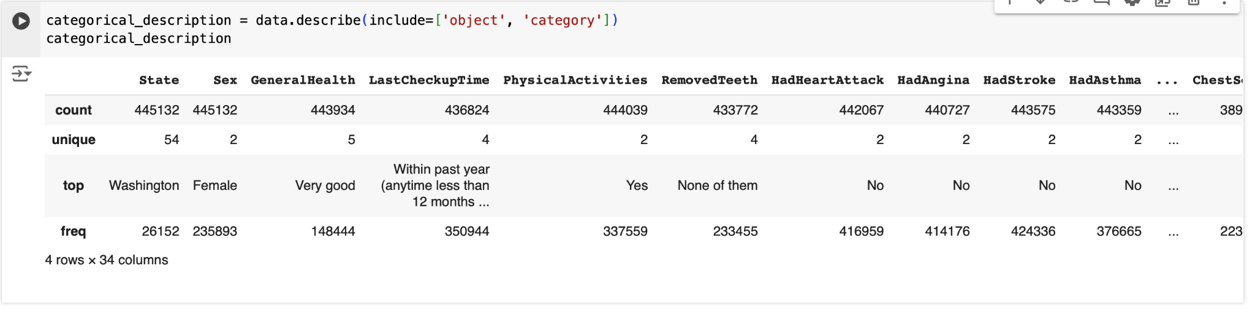
Statistical Analysis for Categorical Data
Analysis 2: Statistical Analysis for Categorical Data

Slide 15
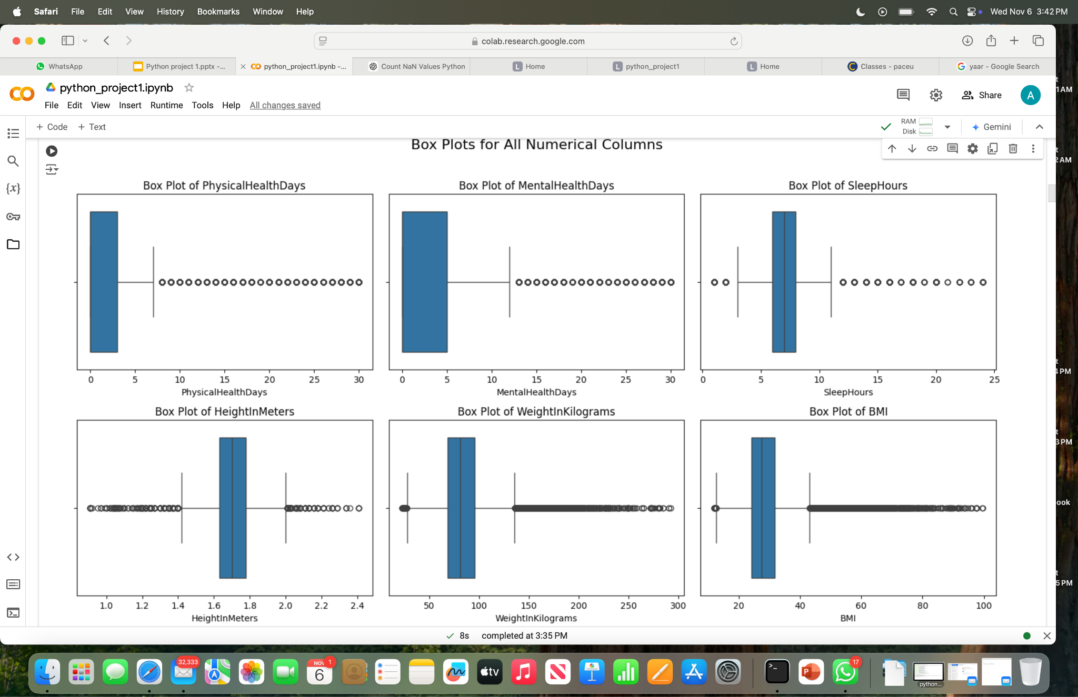
Visualizing Numerical Variables
Analysis 3: Box Plots for Numerical Variables
Box Plots helps to visualize the spread of data and detect potential outliers.
These box plots are created using the raw, uncleaned data.

Slide 16
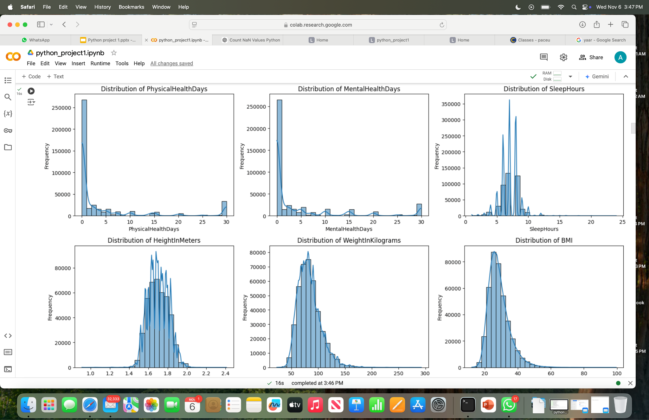
Visualizing Numerical Variables
Analysis 4: Histograms for Numerical Variables
Histograms shows the distribution of each numerical feature and includes a KDE curve to visualize the density
These histograms are generated from the raw, uncleaned data to highlight extreme values and unusual spikes, which can then be addressed during the cleaning process

Slide 17
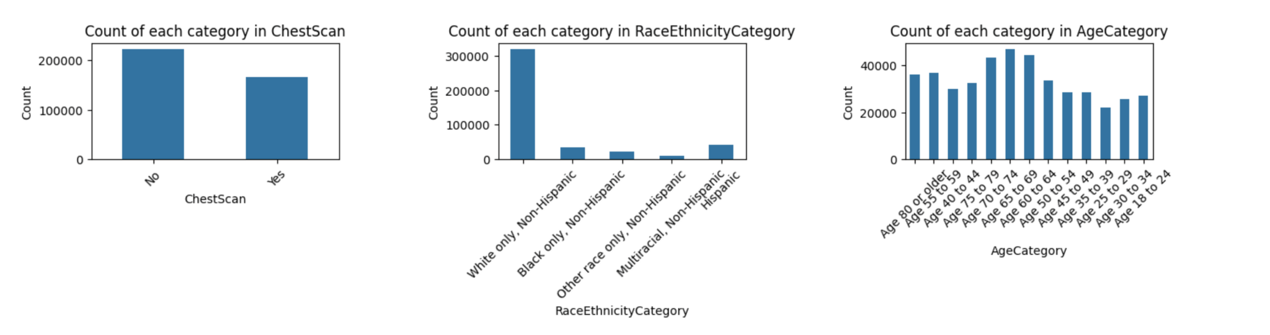
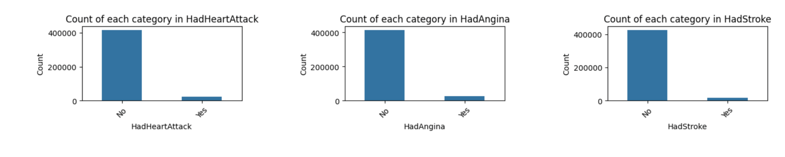
Visualizing Categorical Variables
Analysis 5: Bar Charts for Categorical Variables
Bar Charts: Display the frequency count for each category in the respective column.

Slide 18
Bivariate Analysis
Correlation Analysis: Calculate correlation coefficients to understand relationships between numerical variables using Heatmaps
Cross-tabulation: Analyze relationships between categorical variables using crosstabs
Visualize Relationships:
Scatter Plots: For numerical variables.
Violin Plots: To compare distributions across categories

Slide 19
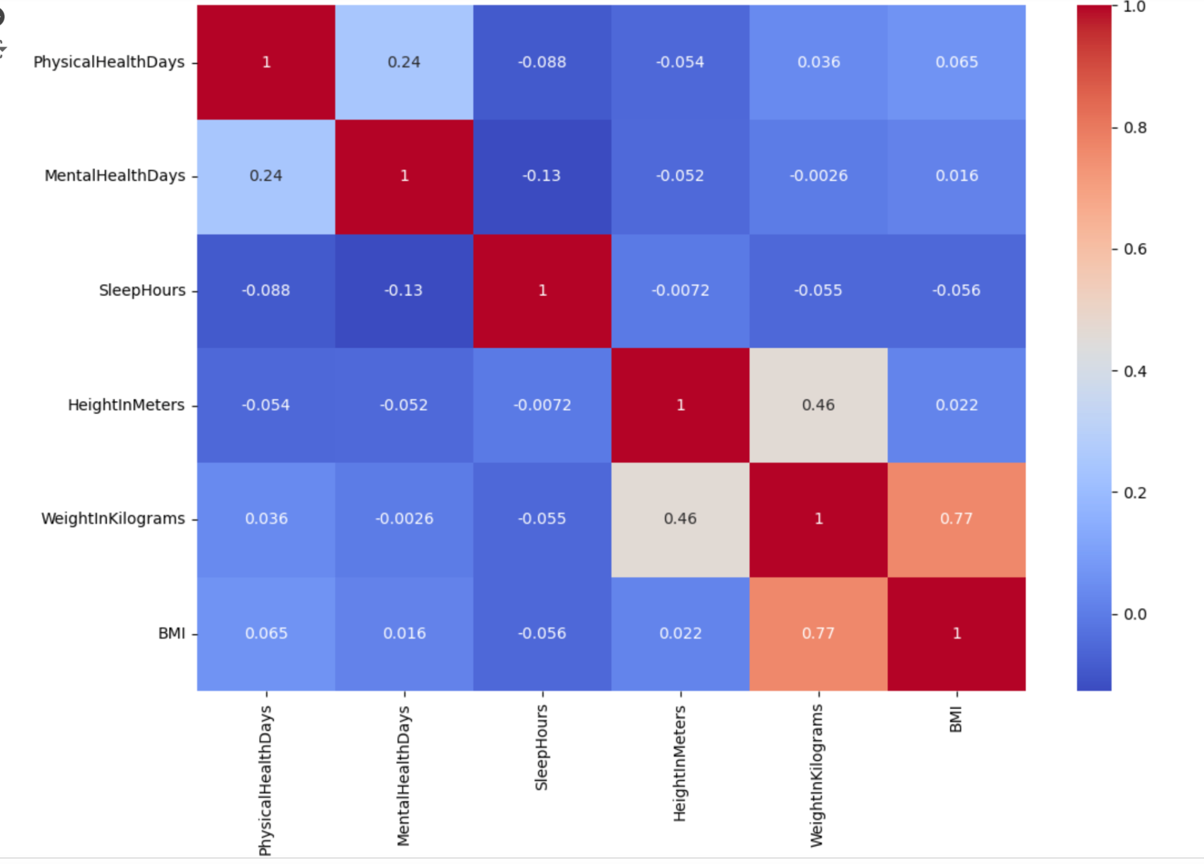
Correlation Analysis
Analysis 6: Heatmaps
Visualize the correlations between numerical variables to detect strong relationships.

Slide 20
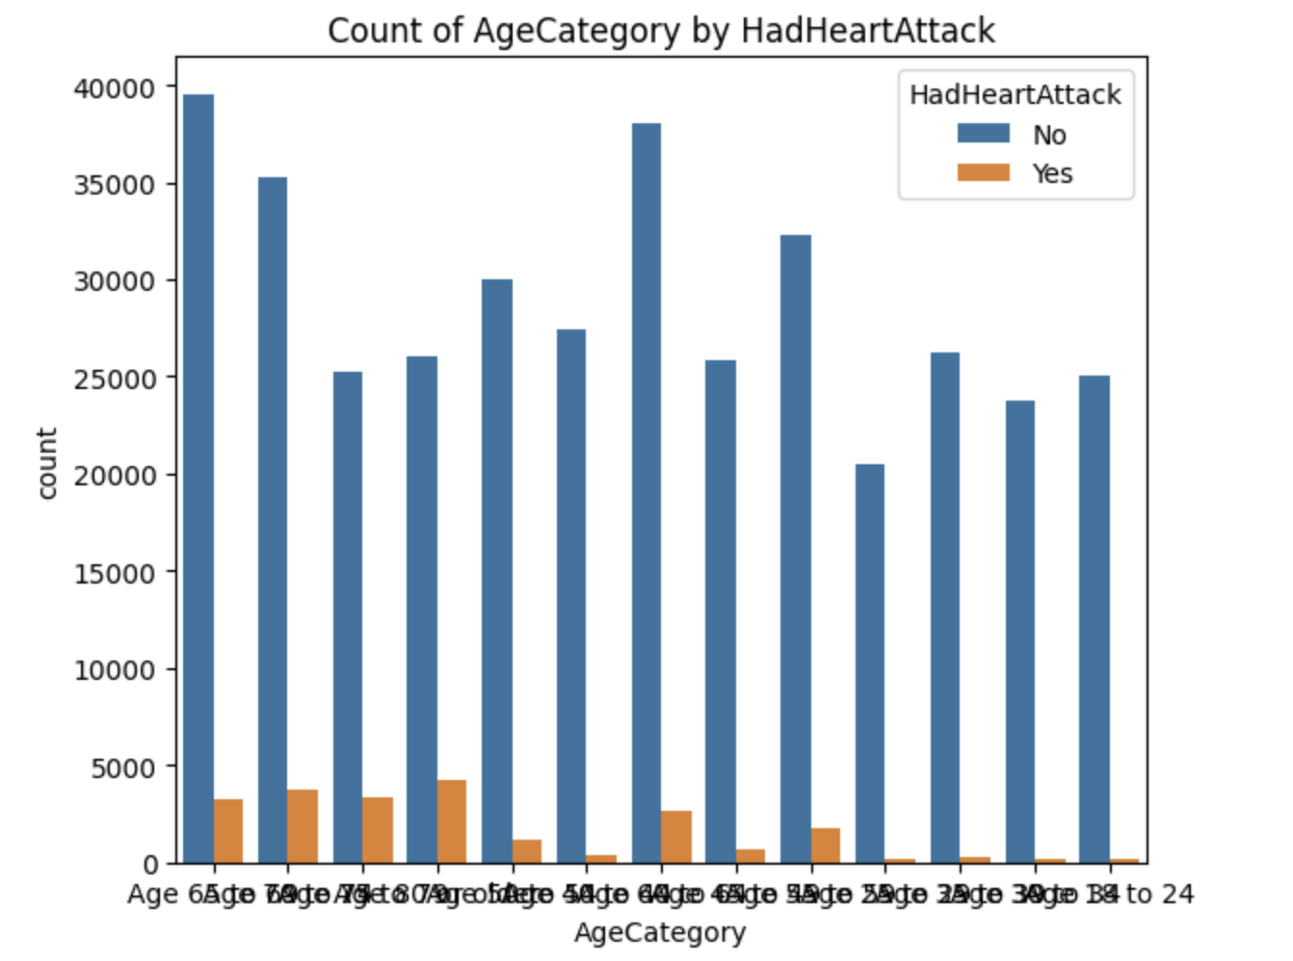
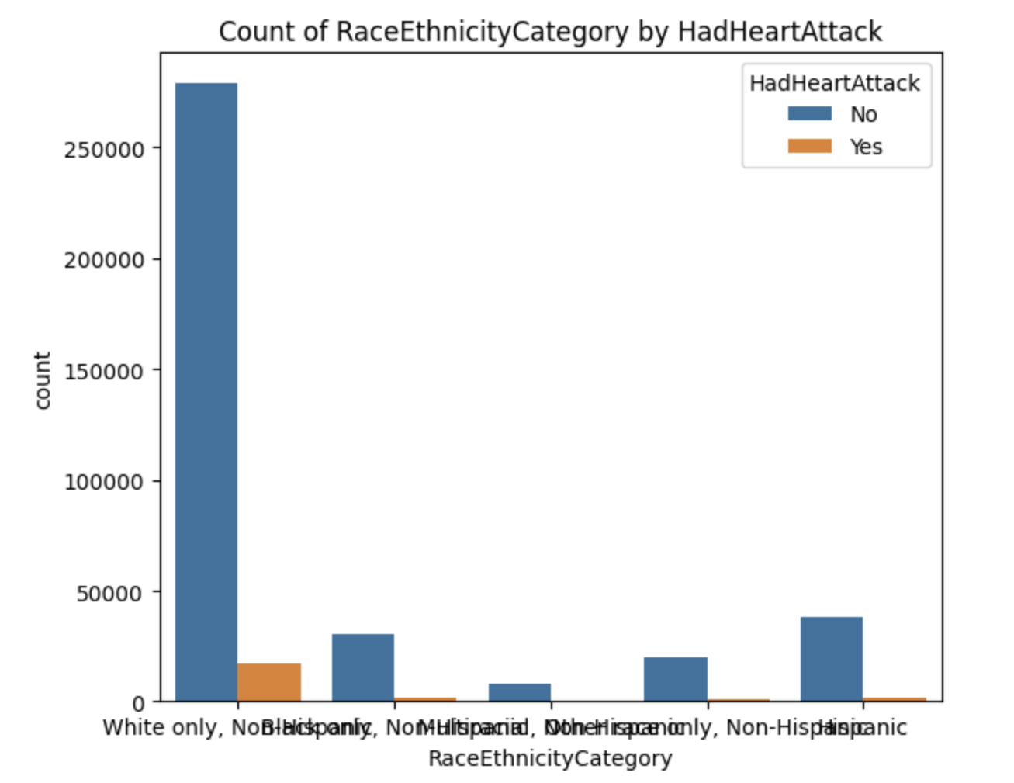
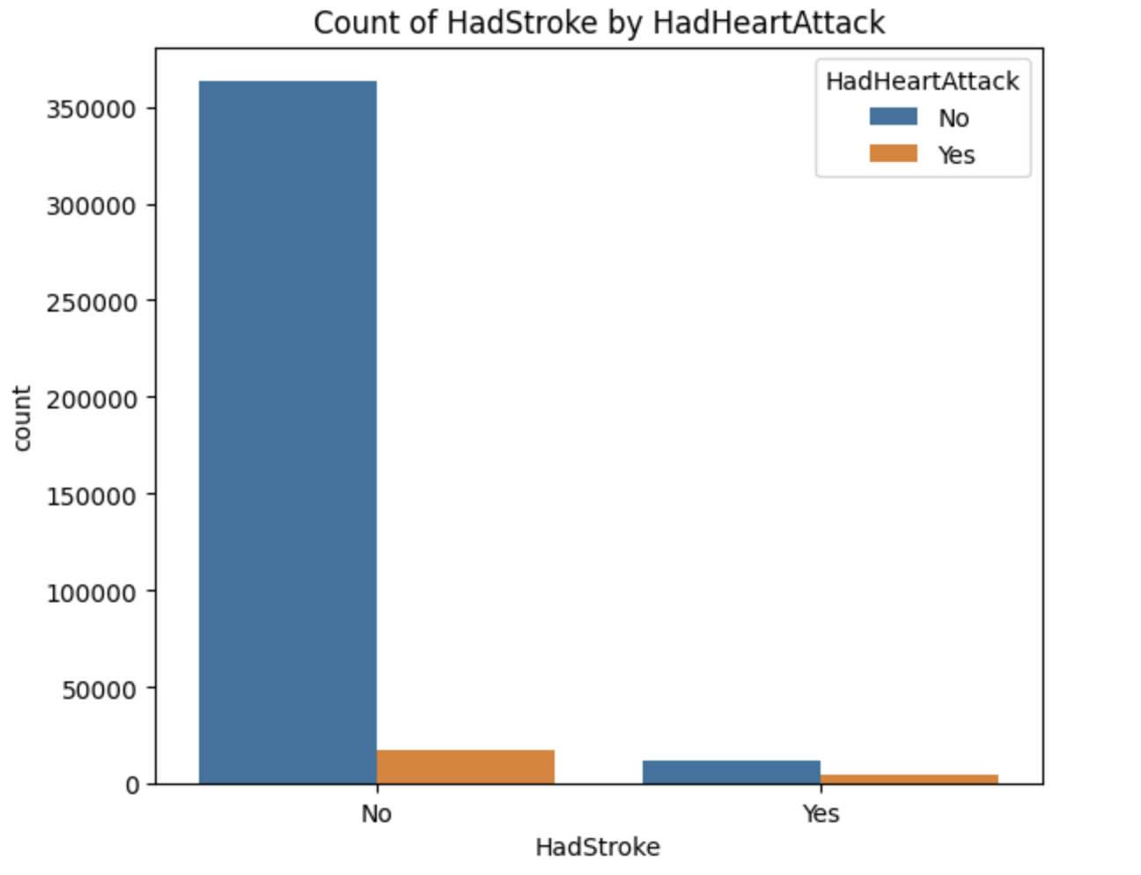
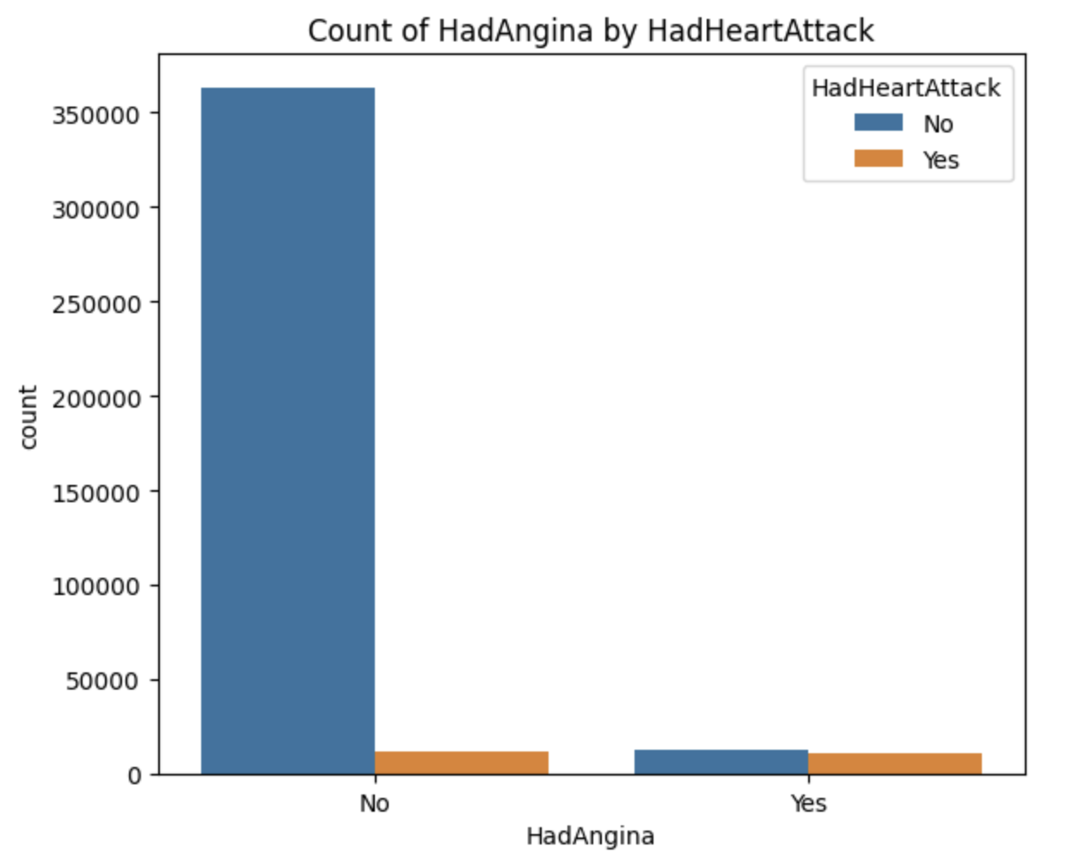
Cross-tabulation
Analysis 7: Crosstab analysis to view relationships between categorical variables
Based on the crosstab analysis, we can conclude that:
Individuals with angina are much more likely to experience a heart attack.
Older individuals have a higher likelihood of experiencing a heart attack compared to younger age groups.
People identified as "white only, non-Hispanic" have a greater likelihood of having a heart attack than those in other racial categories
Those who have had a stroke are at an increased risk of having a heart attack.

Slide 21
Multivariate Analysis
Pairplot/Scatterplot Matrix: Use to visualize relationships between multiple numerical variables

Slide 22
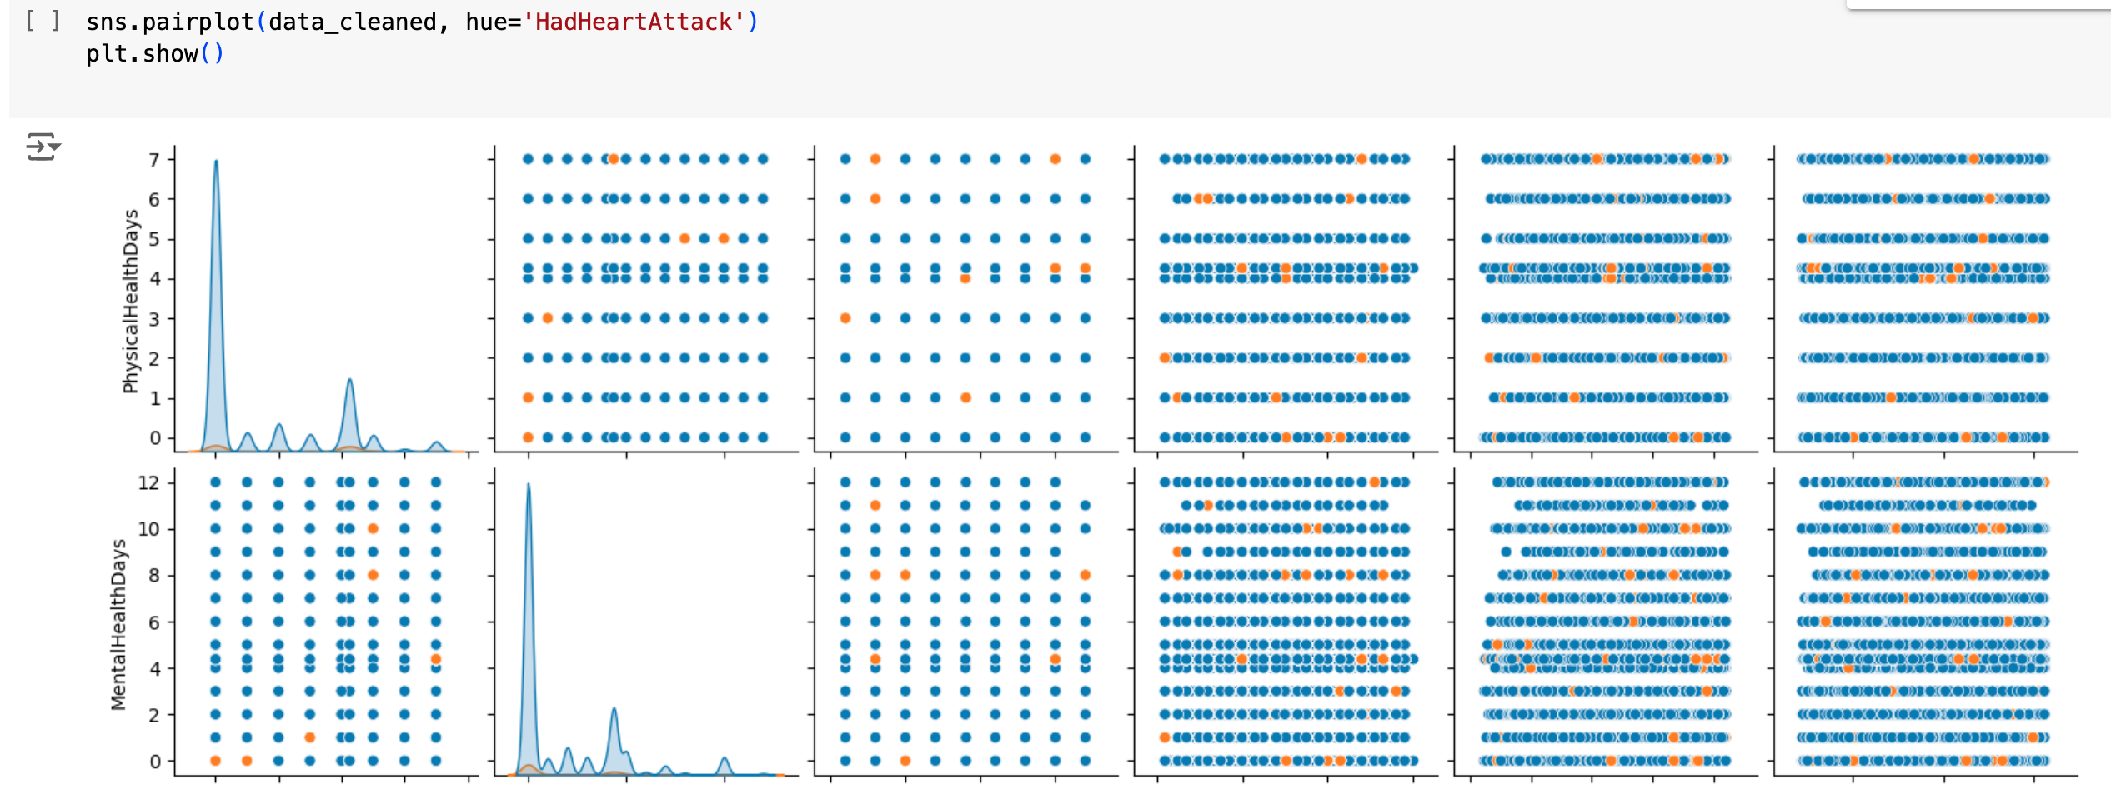
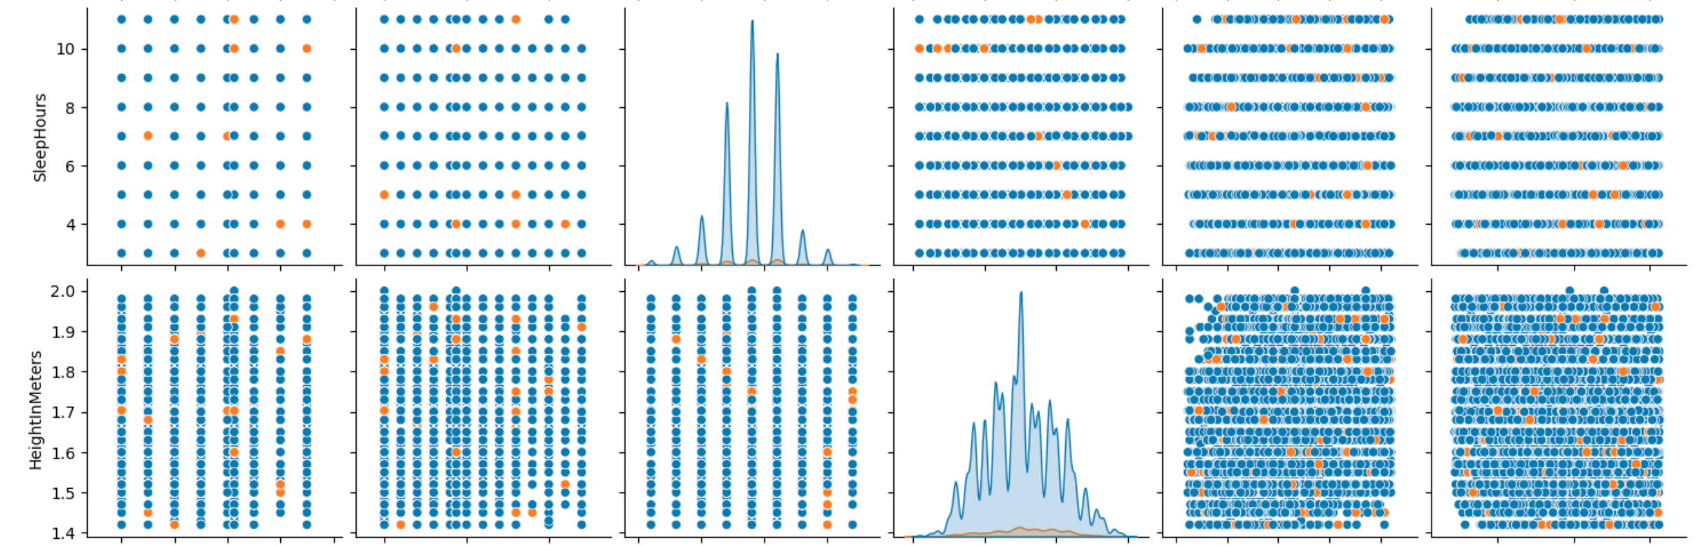
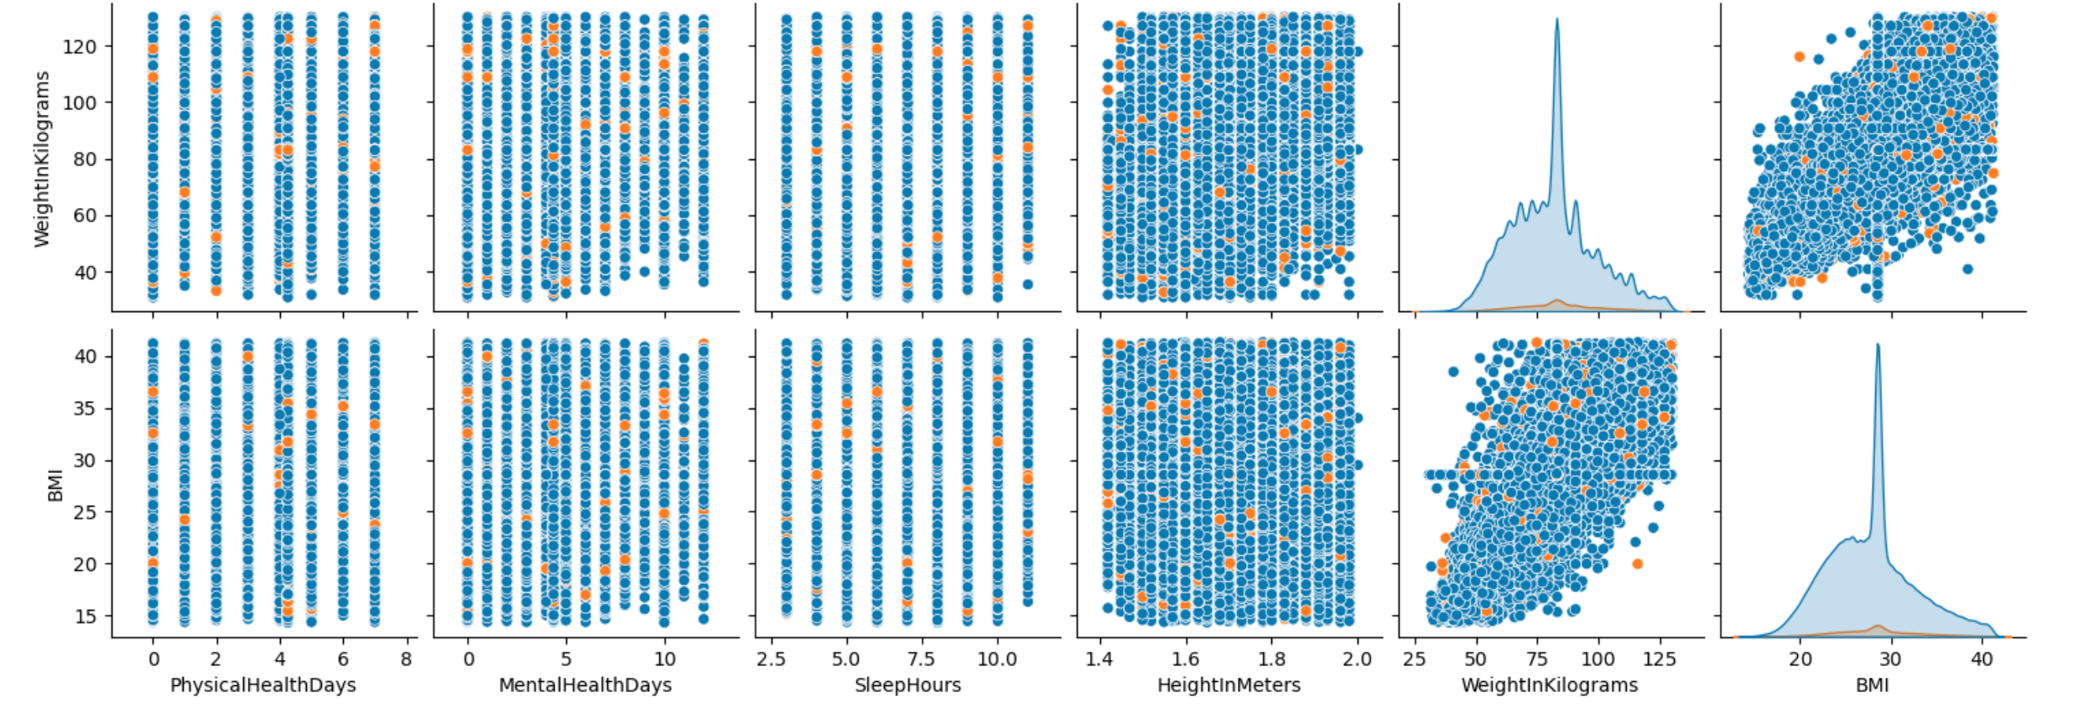
Scatter Plot
Analysis 8: Scatterplot

Slide 23
Conclusion
The analysis of the dataset reveals several important insights regarding the risk factors associated with heart disease:
Angina and Heart Attack Risk: Individuals with angina are significantly more likely to experience a heart attack, highlighting the strong connection between angina and cardiovascular events.
Age and Heart Attack Likelihood: There is a clear trend that older individuals are at a higher risk for heart attacks compared to younger age groups, emphasizing the importance of age as a key risk factor in heart disease.
Racial Demographics: The data indicates that people identified as "White only, non-Hispanic" exhibit a higher likelihood of having a heart attack compared to individuals from other racial groups. This finding warrants further investigation into social, economic, and healthcare access factors that might contribute to these disparities.
Stroke History and Heart Attack Risk: A history of stroke is shown to increase the likelihood of having a heart attack, underlining the need for comprehensive monitoring and management of individuals with a stroke history to prevent further cardiovascular complications.
Distribution of Continuous Features: The features SleepHours, WeightInKilograms, and BMI appear to follow a normal distribution, suggesting that these variables can be treated with traditional statistical methods that assume normality.
Correlations Among Features: We observed no significant correlations between most features, apart from the expected positive correlation between BMI and WeightInKilograms. This is a well-known relationship, as weight directly impacts body mass index.

Slide 24
References
https://www.kaggle.com/datasets/kamilpytlak/personal-key-indicators-of-heart-disease
https://pandas.pydata.org/docs/
https://matplotlib.org/stable/index.html

Slide 25
Github Repository Code
Github Repository Link: https://github.com/puneeth890/python-project-

Slide 26
Thank You!
Team members:
Arjun Mahajan
Sayali Sawant
Pranjali Chandgadkar
Puneeth Chowdhary

